Slide 1




NEXT GEN EMPLOYABILITY PROGRAM
Creating a future-ready workforce
Team Members
College Name
Student Name :Sowmiya M
Student ID : au960221243021
Arunachala College Of Engineering For Women

Slide 2

CAPSTONE PROJECT SHOWCASE
Project Title
Car Rentals Application with Django Framework
Abstract | Problem Statement | Project Overview | Proposed Solution | Technology Used | Modelling & Results | Conclusion

Slide 3
Abstract
The abstract presents an innovative Car Rental Management System (CRMS) designed to address the evolving needs of the car rental industry. This comprehensive system integrates user-friendly interfaces for customers, real-time vehicle tracking, and robust administrative functionalities. By streamlining reservation processes, optimizing fleet utilization, and ensuring data security, the proposed CRMS aims to enhance operational efficiency, improve customer satisfaction, and enable rental companies to gain a competitive edge. With its scalability and adaptability, the CRMS caters to the requirements of various rental businesses, empowering them to meet the challenges of a dynamic market landscape and stay ahead in the competitive car rental industry.
Source :

Slide 4
Problem Statement
The online car rental website industry is grappling with several critical challenges, including cumbersome reservation processes, inefficient fleet management, and cybersecurity vulnerabilities. Existing platforms often lack intuitive interfaces, leading to customer frustration and diminished user experience. Moreover, ineffective fleet utilization results in increased maintenance costs and decreased profitability for rental businesses. Furthermore, the growing concern over data privacy and security poses a significant threat to customer trust and retention. To address these challenges, there is an urgent need for the development of an innovative online Car Rental Management System (CRMS) that streamlines reservation procedures, optimizes fleet utilization through real-time monitoring, and implements robust cybersecurity measures. By providing a solution tailored to the online environment, the proposed CRMS aims to revolutionize the car rental website industry, enhancing operational efficiency, improving customer satisfaction, and ensuring the long-term success of online rental platforms
Source :

Slide 5
Project Overview
The project involves creating a Car Rental Management System (CRMS) for an online car rental website. This system will streamline reservation processes, optimize fleet management, and enhance data security.
Key features:
User-friendly interfaces
Efficient reservation management
Real-time vehicle tracking
Administrative tools
Robust data
Security measures.
Benefits:
Improved customer experience
Operational efficiency,
Data security
Business insights
A competitive edge in the market.
Overall, the CRMS will revolutionize the online car rental industry by offering a seamless booking experience, optimizing operations, and ensuring data security and compliance
Source :

Slide 6
Proposed Solution
.
Our proposed solution is an innovative Car Rental Management System (CRMS) tailored for an online car rental website. This system will revolutionize the online car rental experience by offering a seamless and efficient booking process for customers while optimizing fleet management and ensuring data security for rental companies. Through intuitive user interfaces, customers will be able to easily search for vehicles, make reservations, and manage bookings with minimal effort. Real-time fleet optimization will maximize vehicle utilization, reduce idle time, and improve maintenance scheduling, enhancing operational efficiency and reducing costs. Additionally, robust administrative tools will empower rental companies to effectively manage vehicle inventory, track rental transactions, and generate insightful reports for informed decision-making. With stringent data security measures in place, including encryption protocols and authentication mechanisms, customer data will be safeguarded, ensuring trust and compliance with data privacy regulations. Overall, our CRMS will offer a competitive edge to the online car rental website, delivering a superior user experience, operational efficiency, and data security.
Source :

Slide 7
Scope
Development of a Car Rental Management System (CRMS) for an online car rental website.
Features include user-friendly reservation interfaces and efficient booking management.
Real-time vehicle tracking and maintenance scheduling for fleet optimization.
Administrative tools for inventory management and report generation.
Implementation of robust data security measures for customer data protection.
Integration with existing systems and scalability for future expansion.
User training and support to ensure smooth adoption.
Potential applications in fleet management and transportation logistics.
Source :

Slide 8
Functional and Non Functional Requirements
The functional requirements are as follows:
User Authentication: Secure login and registration for users.
Vehicle Booking: Search, book, modify, and cancel reservations.
Fleet Management: Add, update, and track vehicle availability and maintenance.
Administrative Tools: Manage user accounts, monitor transactions, and generate reports.
Real-time Tracking: Track vehicle locations and statuses for optimal fleet management.
Payment Processing: Support secure online payments for reservations.
Email Notifications: Automated emails for booking confirmations and updates.
The non functional requirements are as follows:
Performance: Efficient handling of high user loads with minimal latency.
Security: Data encryption, secure authentication, and access controls.
Usability: Intuitive user interface with clear instructions
Reliability: High availability, minimal downtime, and error handling.
Scalability: Ability to scale to accommodate growing demands.
Compatibility: Compatibility across devices and browsers.
Source :

Slide 9


Technology Used
Front-end
Back-end
Source :

Slide 10
Modelling & Results
1. System Design:
- Analyze requirements.
- Create detailed system design.
- Specify UI, database, backend logic.
- Expected Result: System design document.
2. Development:
- Implement system using web technologies.
- Frontend and backend development.
- Follow best practices.
- Expected Result: Fully functional prototype.
3. Testing:
- Rigorous testing for reliability, performance, usability.
- Functional, usability, performance, security testing.
- Expected Result: Thoroughly tested system.
4. Deployment:
- Deploy to production environment.
- Configure infrastructure, deploy code.
- Monitor and address issues.
- Expected Result: Live system ready for use.
Source :

Slide 11
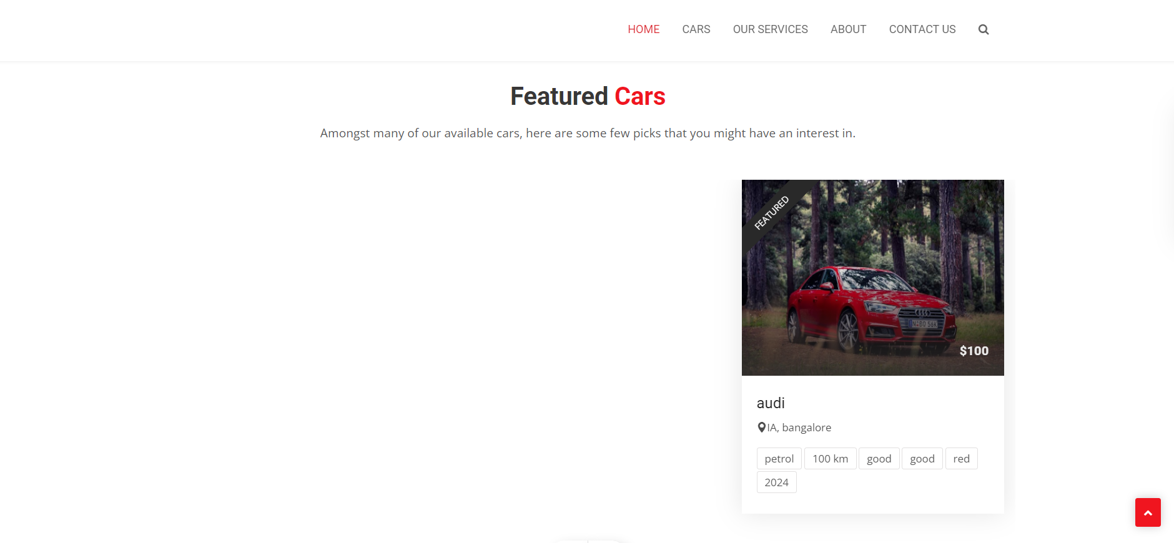
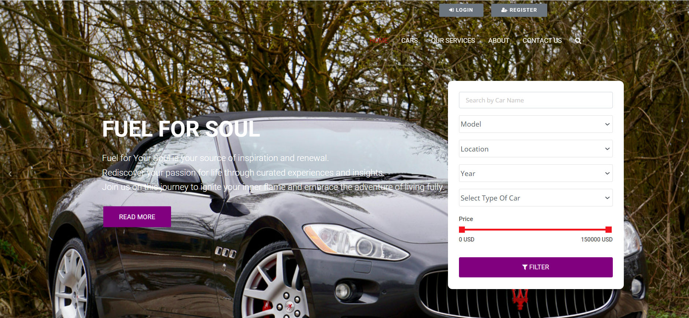
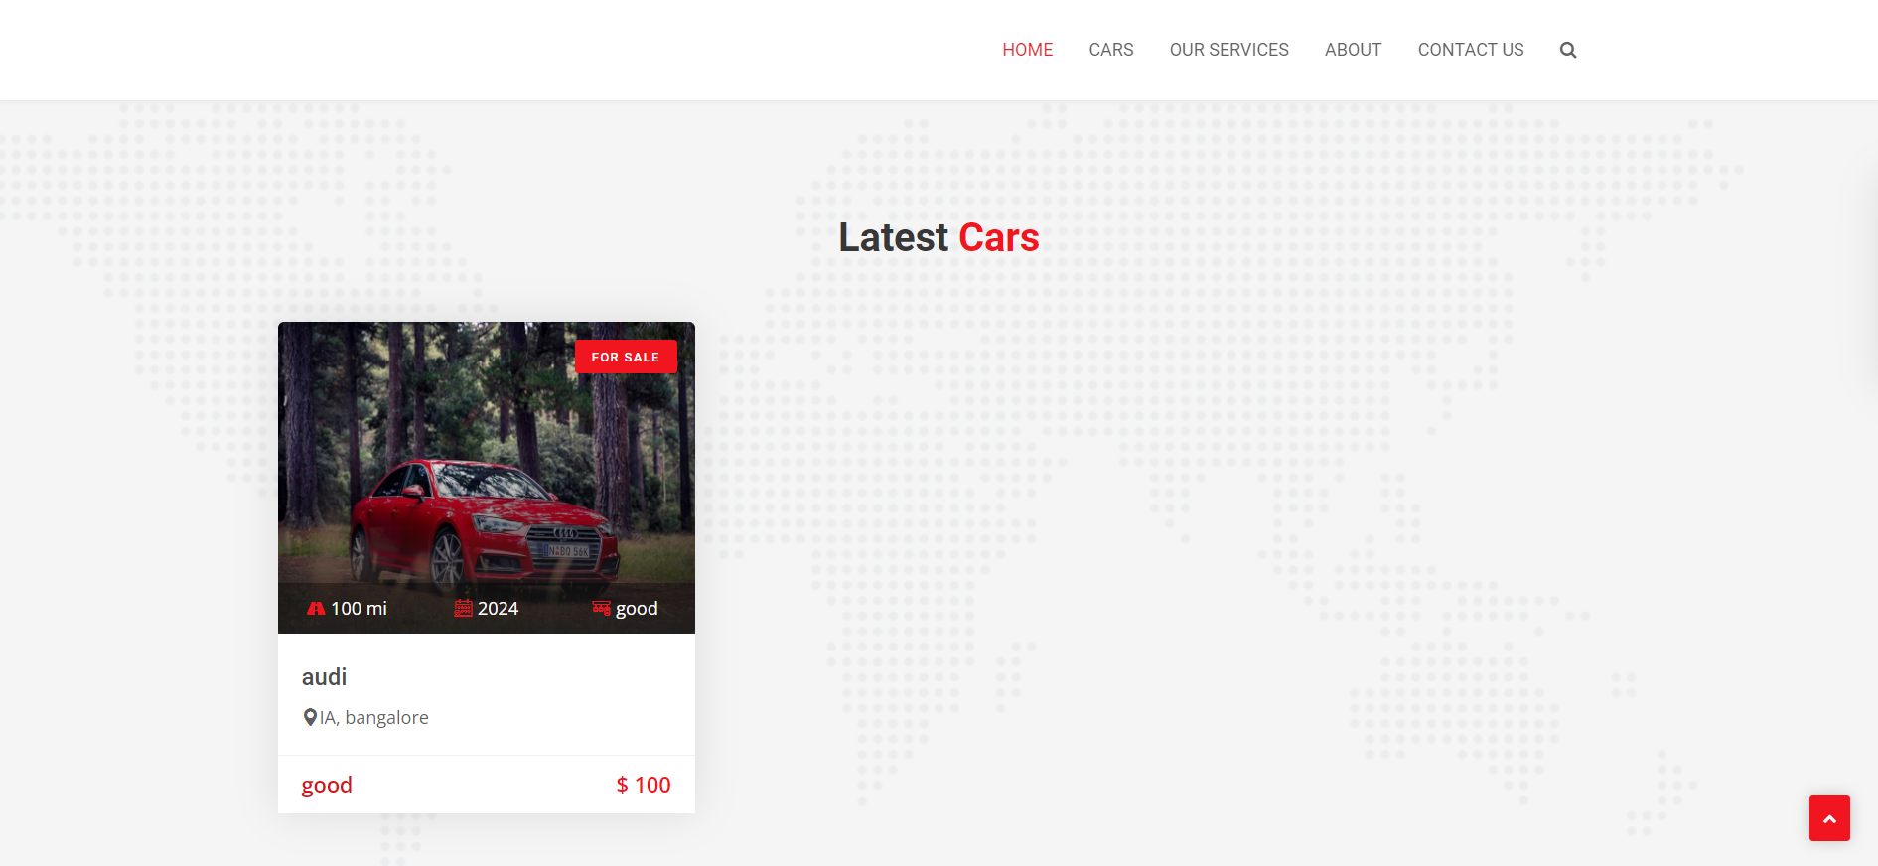
Homepage

Slide 12
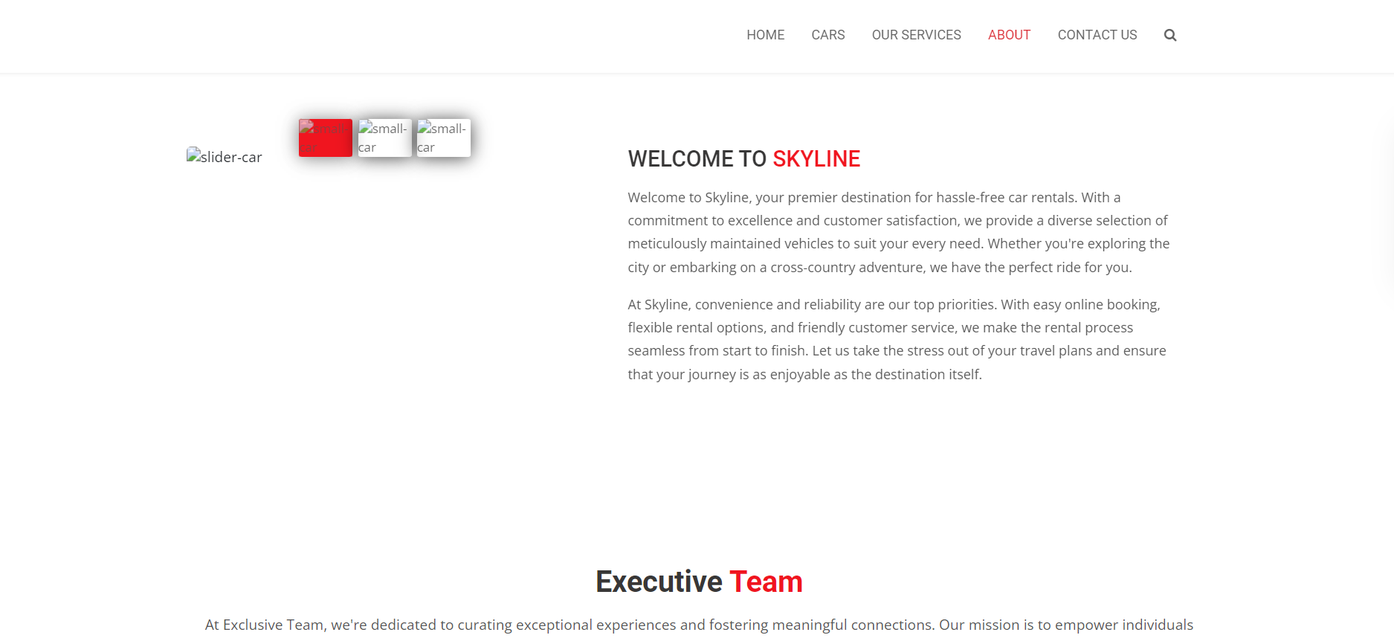

About-Us-Page

Slide 13
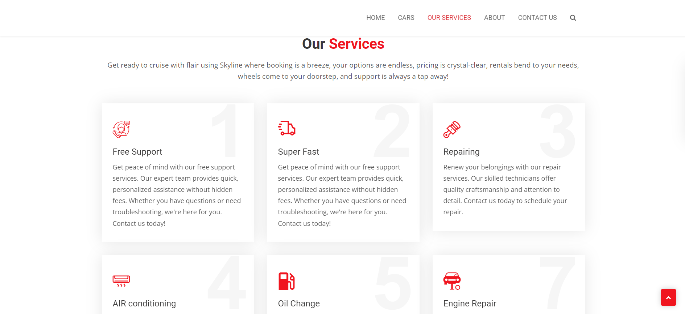
Service-Page

Slide 14
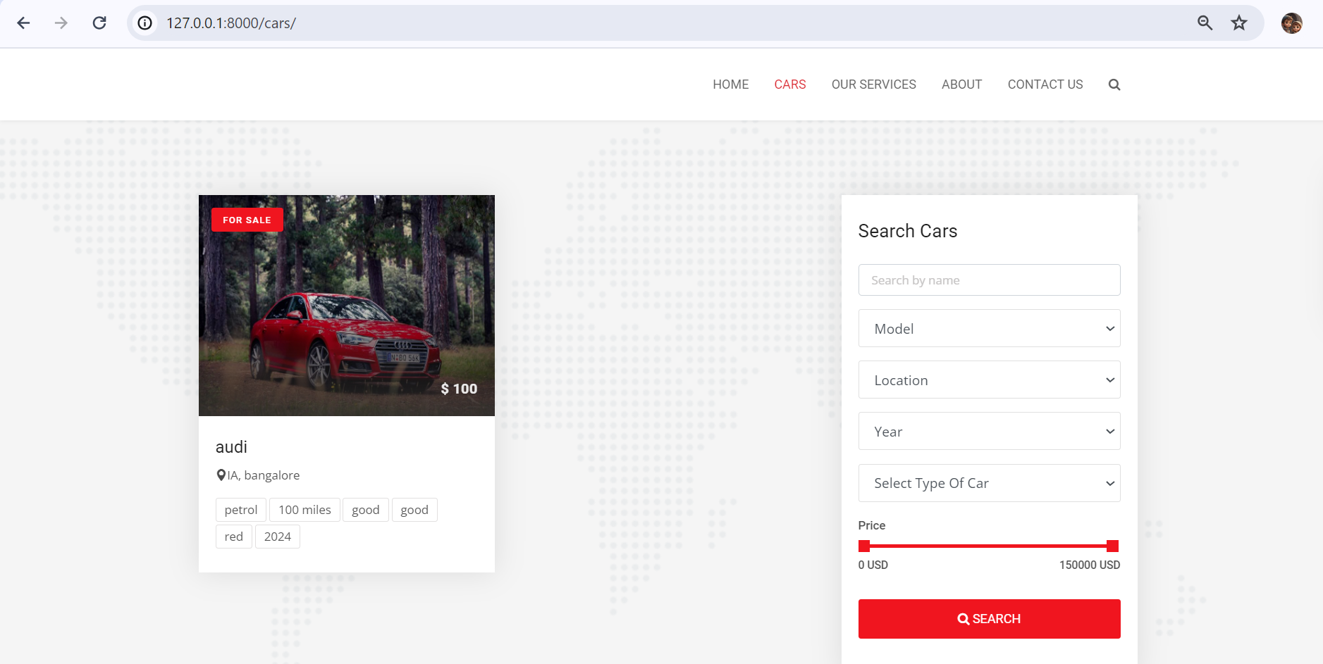
Departments-Page

Slide 15
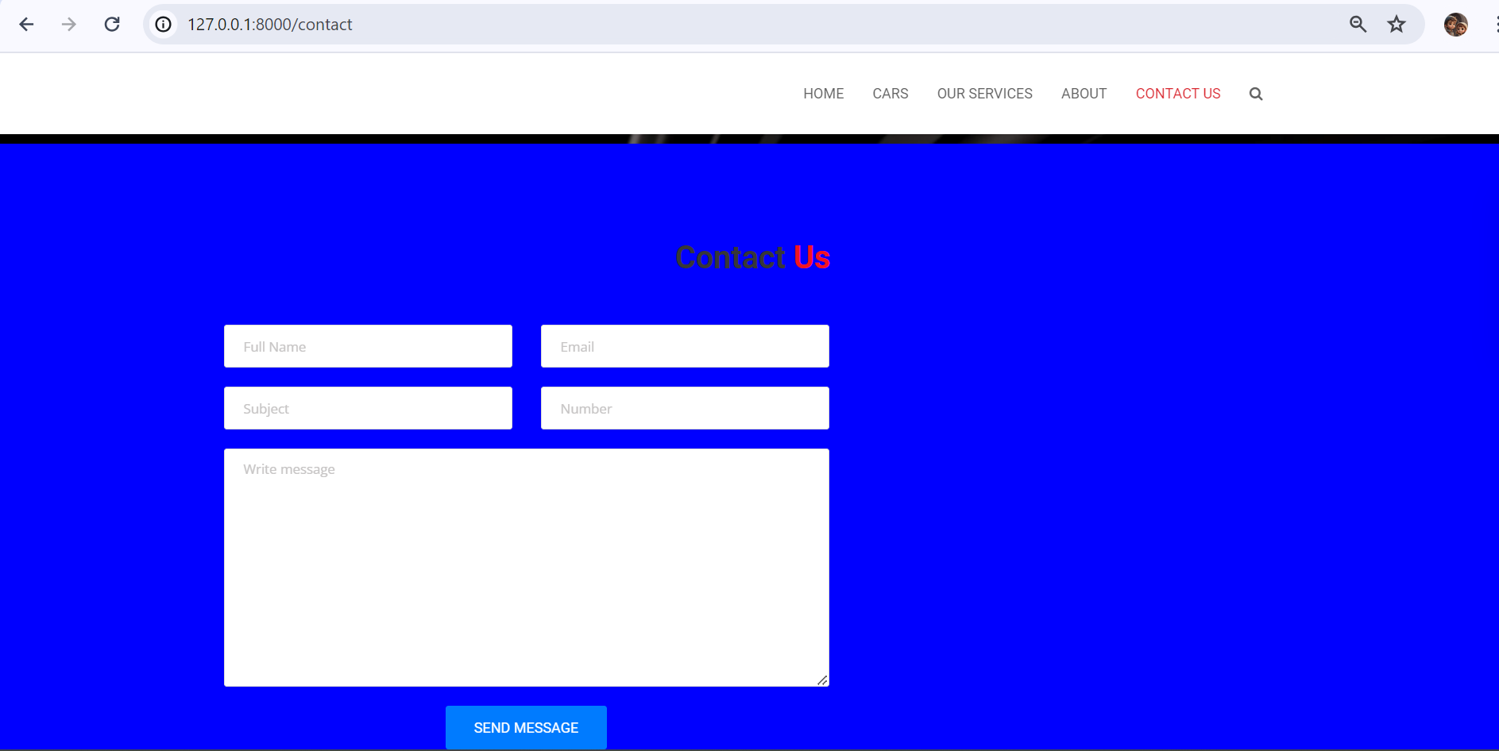
Blog-Page

Slide 16
Future Enhancements:
Mobile Application Development: Developing a mobile application for the car rental service to provide customers with on-the-go access to reservations, vehicle tracking, and account management.
Integration with Vehicle Telematics: Integrating the car rental system with vehicle telematics systems to provide real-time data on vehicle performance, location, and fuel efficiency, enhancing fleet management capabilities.
AI-Powered Recommendation Engine: Implementing an AI-powered recommendation engine to suggest personalized vehicle options based on customer preferences, rental history, and current demand trends.
Predictive Maintenance: Implementing predictive maintenance algorithms to anticipate and schedule vehicle maintenance based on usage patterns, reducing downtime and improving fleet reliability.
Expanded Payment Options: Introducing additional payment options such as digital wallets and cryptocurrency to accommodate diverse customer preferences and enhance convenience.

Slide 17
Conclusion
In conclusion, the development of a comprehensive Car Rental Management System (CRMS) holds significant potential for enhancing the efficiency, customer experience, and competitiveness of car rental businesses. Through the systematic design, development, testing, and deployment of the CRMS, rental companies can streamline reservation processes, optimize fleet management, and ensure data security.
Moreover, future enhancements such as mobile app integration, AI-driven recommendations, and predictive maintenance algorithms promise to further elevate the car rental experience and unlock new opportunities for growth and innovation. By embracing these advancements and continually adapting to evolving customer needs and market trends, car rental businesses can position themselves for long-term success in an increasingly competitive landscape.
Source :

Slide 18
Thank You!
Notes:
Thank You !!

